Slide 1

GaussDB-Vector:
A Large-Scale Persistent Real-Time Vector
Database for LLM Applications
1

Slide 2
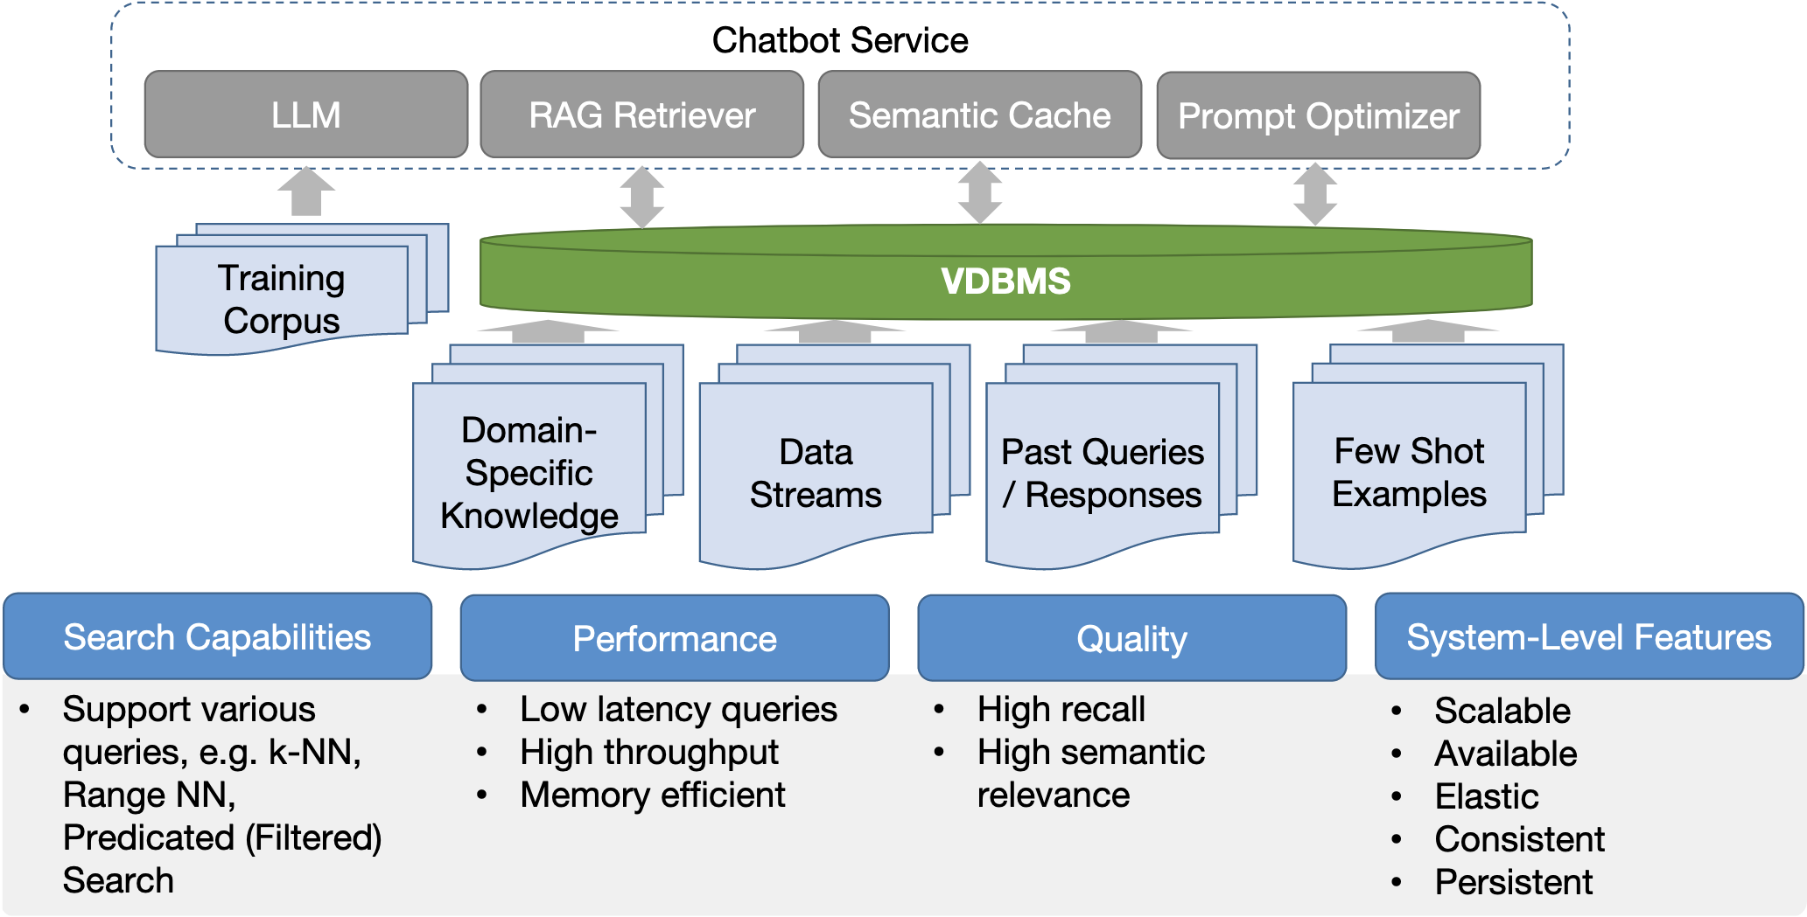
Introduction - VDBs and LLMs
2

Slide 3

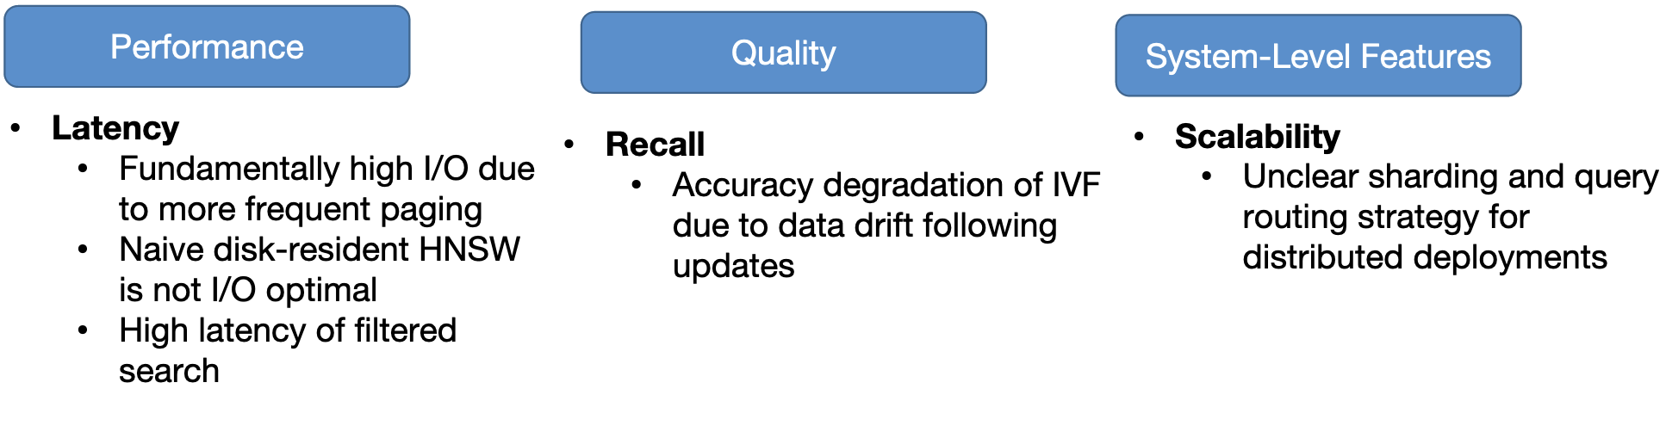
Vector Databases: Key Challenges
More and more applications rely on embedding vectors that are retrieved via similarity search
Goal: Store embeddings in a DB and retrieve for whatever downstream task
Size: Existing hardware not for large data units
Structure: Lack of structure (e.g. attrs) makes embeddings hard to index
3

Slide 4
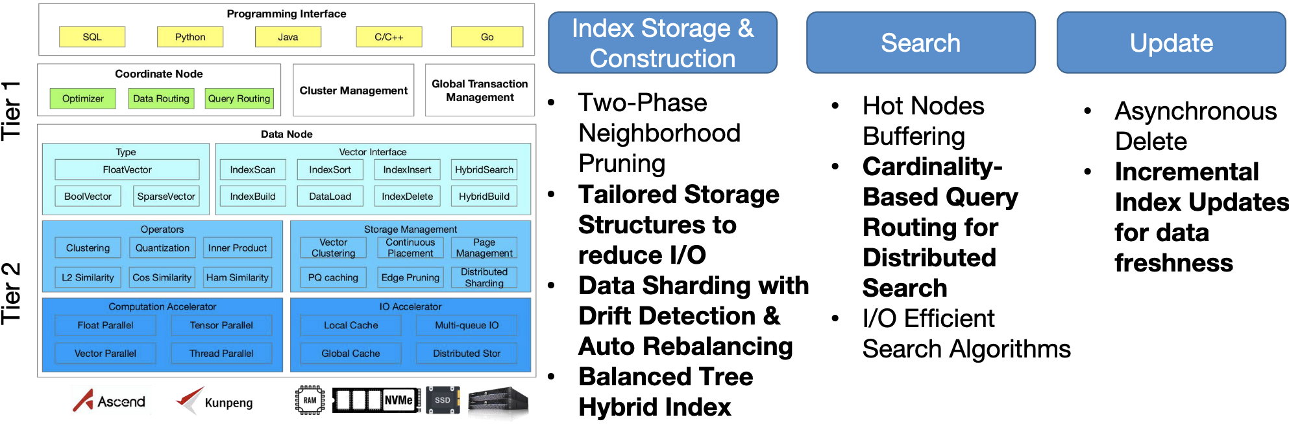
GaussDB-Vector
Build a distributed persistent real-time database based on IVF & DiskANN
Architecture: Two-Tiered Distributed Database to provide scalability / availability
Techniques: IVF & DiskANN but make it easier to build, update, and search
4

Slide 5
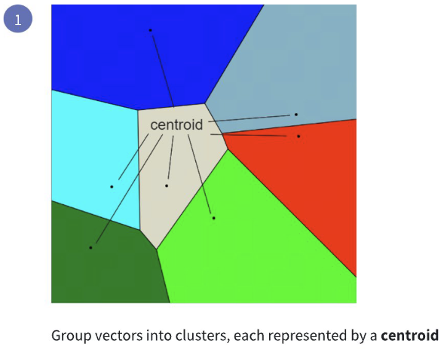
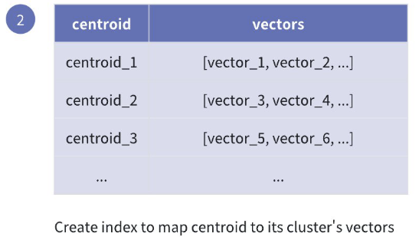
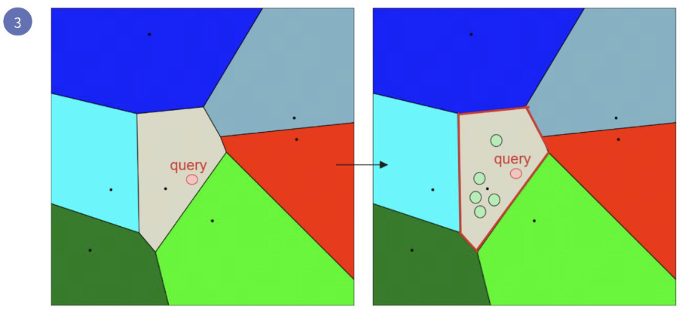
IVF ANN INDEX
When a query vector is provided:
Calculate its distance to each centroid to find the nearest clusters.
Retrieve vectors from these clusters using the inverted index.
Perform similarity computations only within the retrieved vectors to identify the most similar results.
5

Slide 6
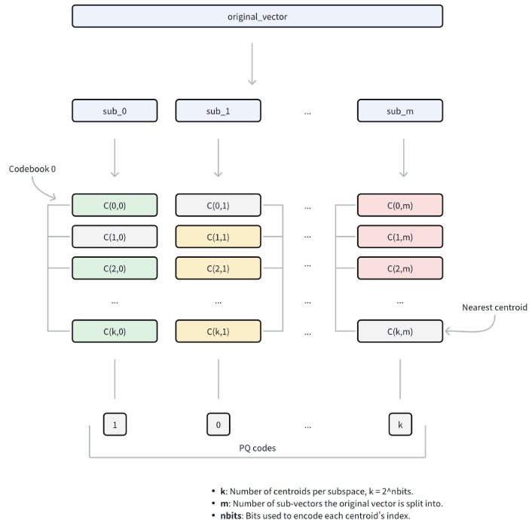
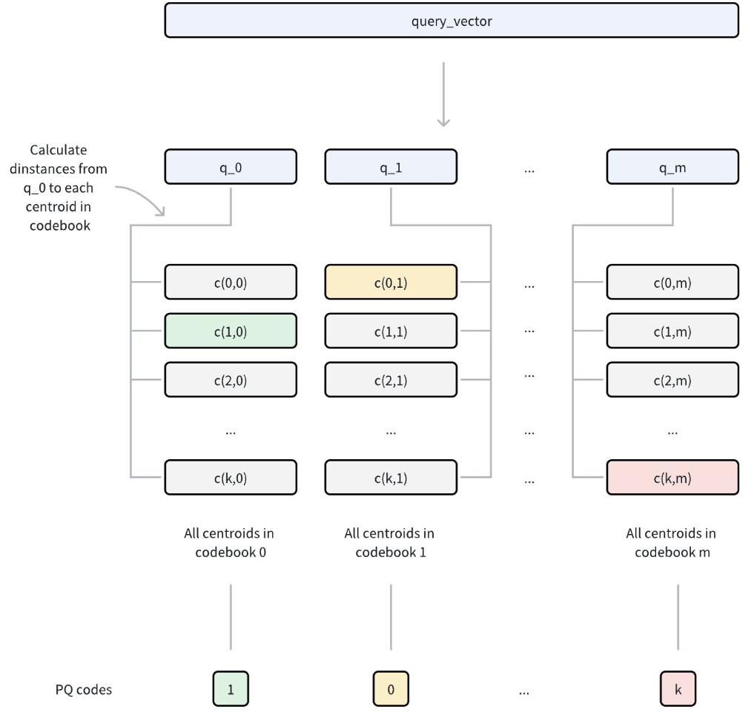
IVF-PQ
6

Slide 7
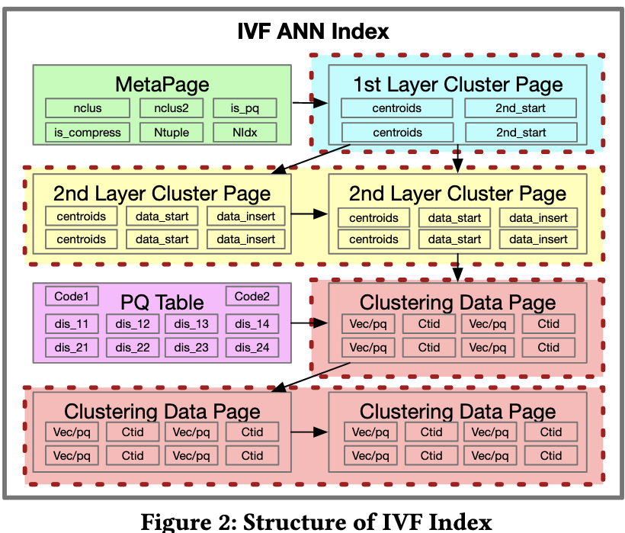
STRUCTURE OF IVF ANN INDEX
Uses two-layer clustering for the IVF index in order to balance the load of clusters.
Selects top- Nclusters and top-M sub-clusters based on centroid similarity.Set N*M to cover 5–10% of the dataset proves effective in achieving high recall with minimal latency
Binary sort on vectors according to distance to the query.
7

Slide 8
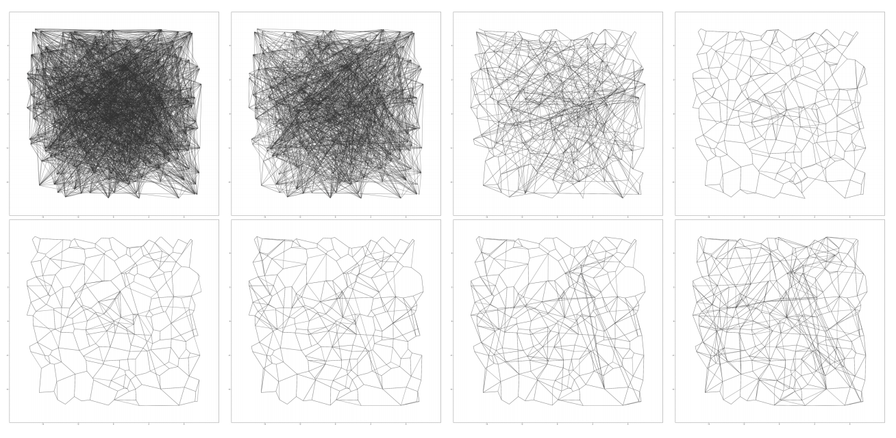
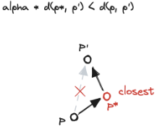
GRAPH ANN INDEX CONSTRUCTION
Vamana
1.Random Initialization
2.Navigation Point Selection
3.First Iteration (α=1）: For every point, an approximate nearest neighbor search is run starting from the navigation point. All nodes visited along the search path are added to the candidate set, followed by edge pruning with α=1to establish connectivity.
4.Refinement Iteration (α>1): To address the low quality of the initial random graph, the search and pruning process is repeated with a relaxed threshold (e.g., α=1.2).
8

Slide 9
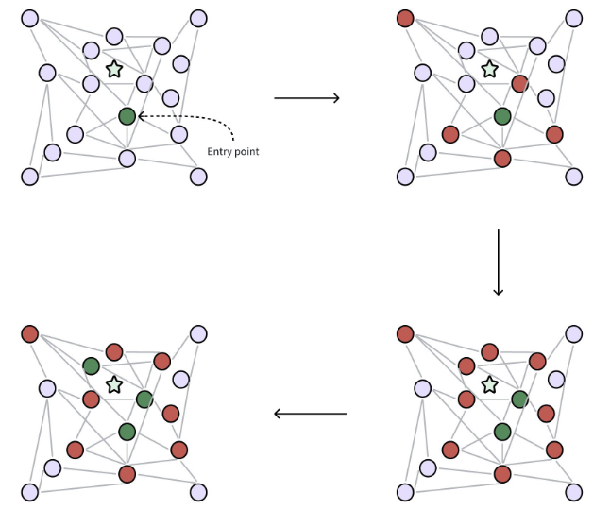
GRAPH ANN INDEX
Optimization Strategies：
Scalable Graph Construction via Overlapping Partitioning
PQ-based Storage in memory
Data organized into fixed-length records [raw-vector, Rneightbors]
Entry-Region Caching
Beam Search
9

Slide 10
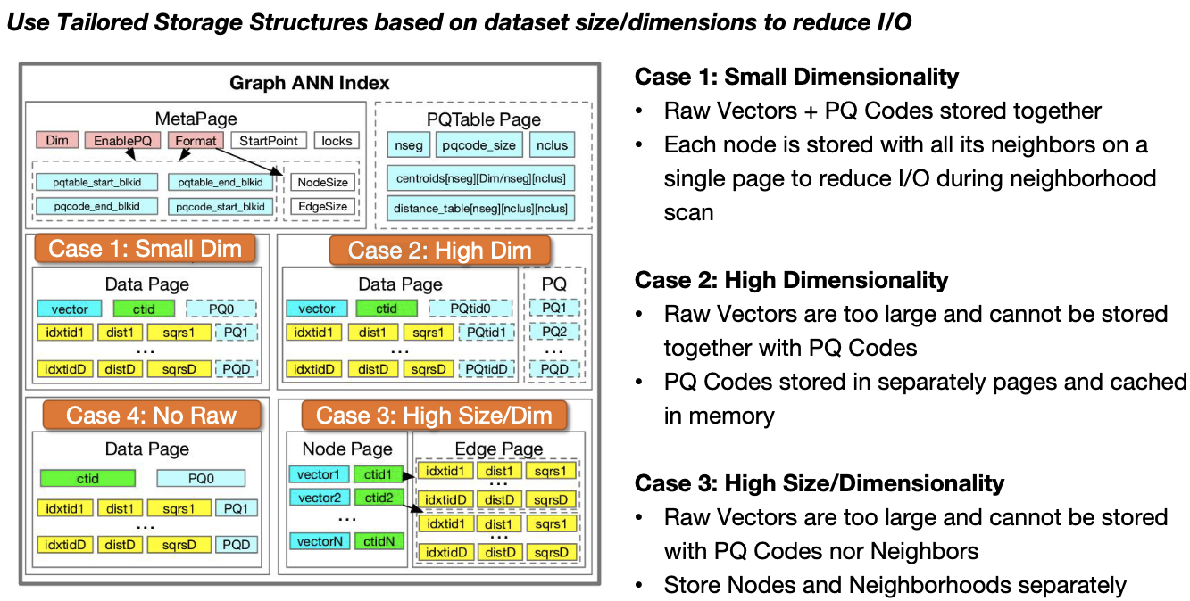
STRUCTURE OF GRAPH ANN INDEX
10

Slide 11
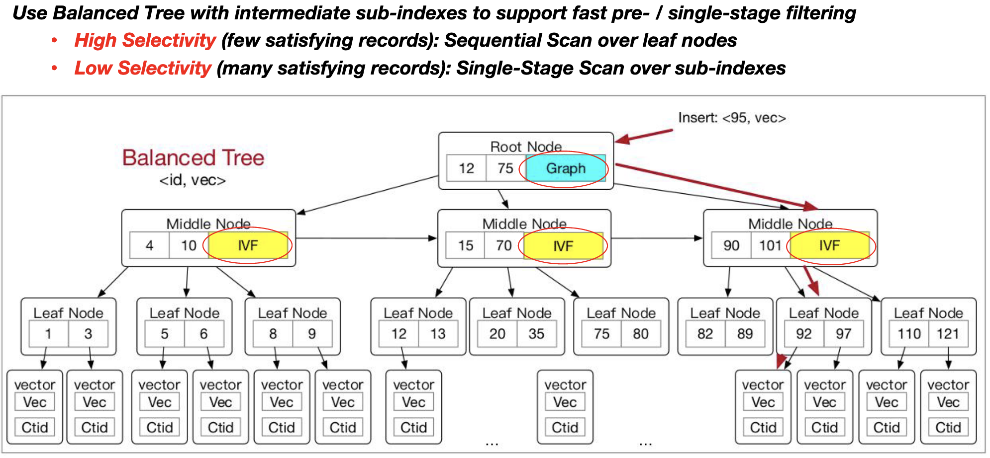
Balanced Tree Hybrid Index
11

Slide 12
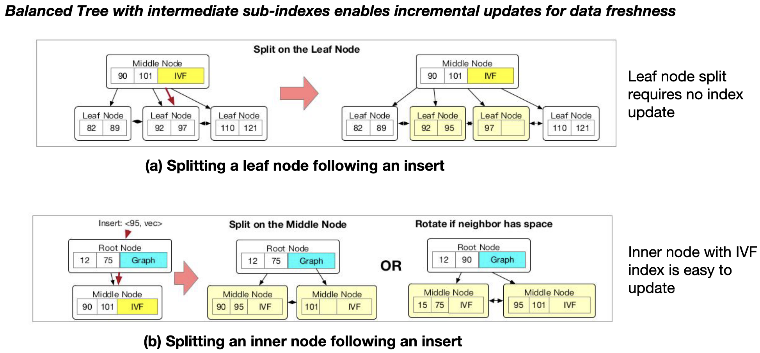
Incremental Index Updates
12

Slide 13
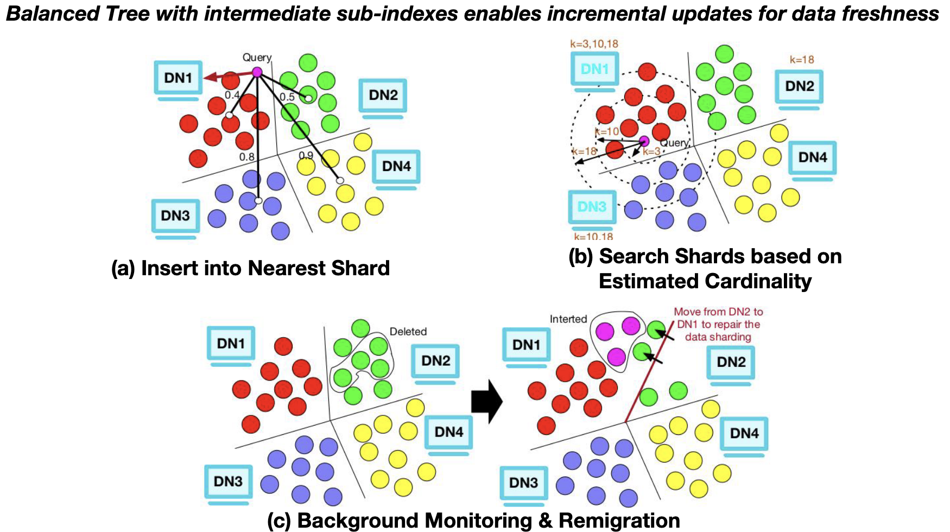
Data Sharding & Distributed Search
13

Slide 14
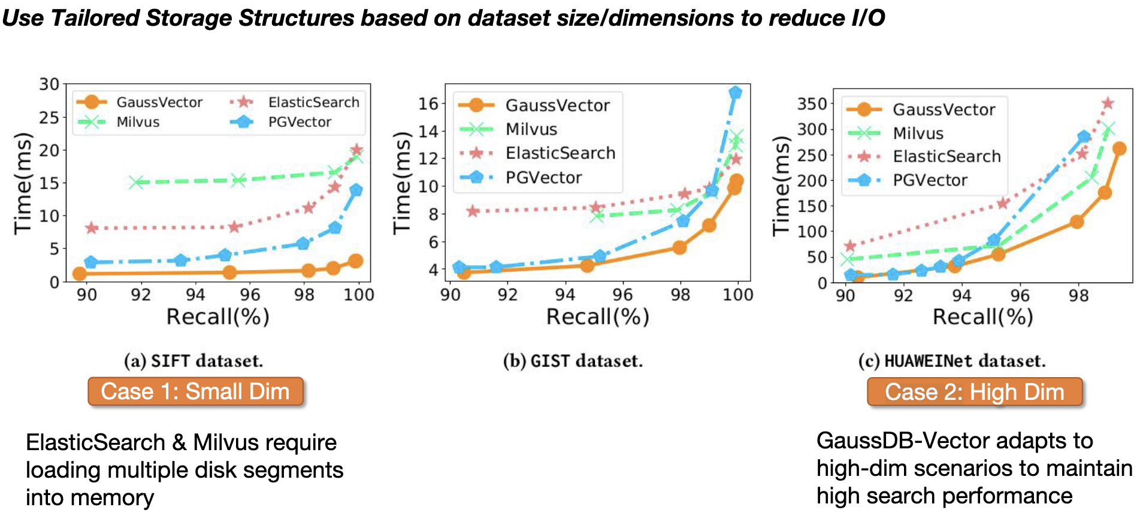
Tailored Storage Structures
14

Slide 15
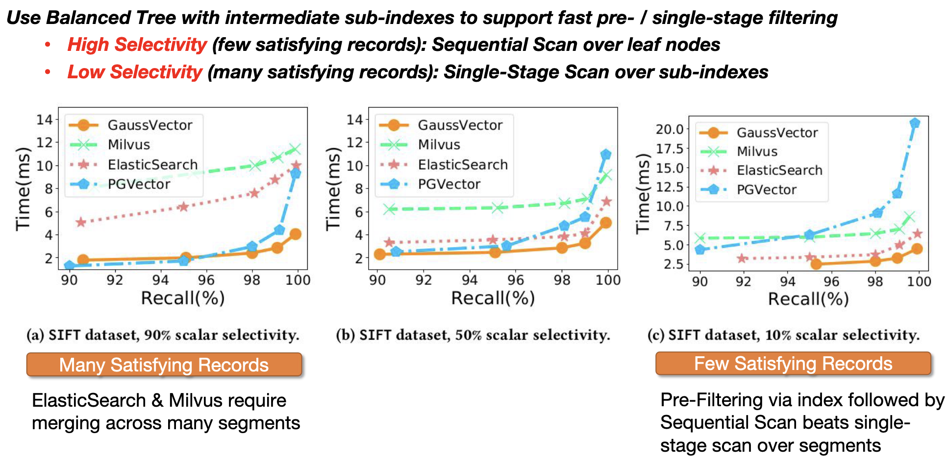
Balanced Tree Hybrid Index
15

Slide 16
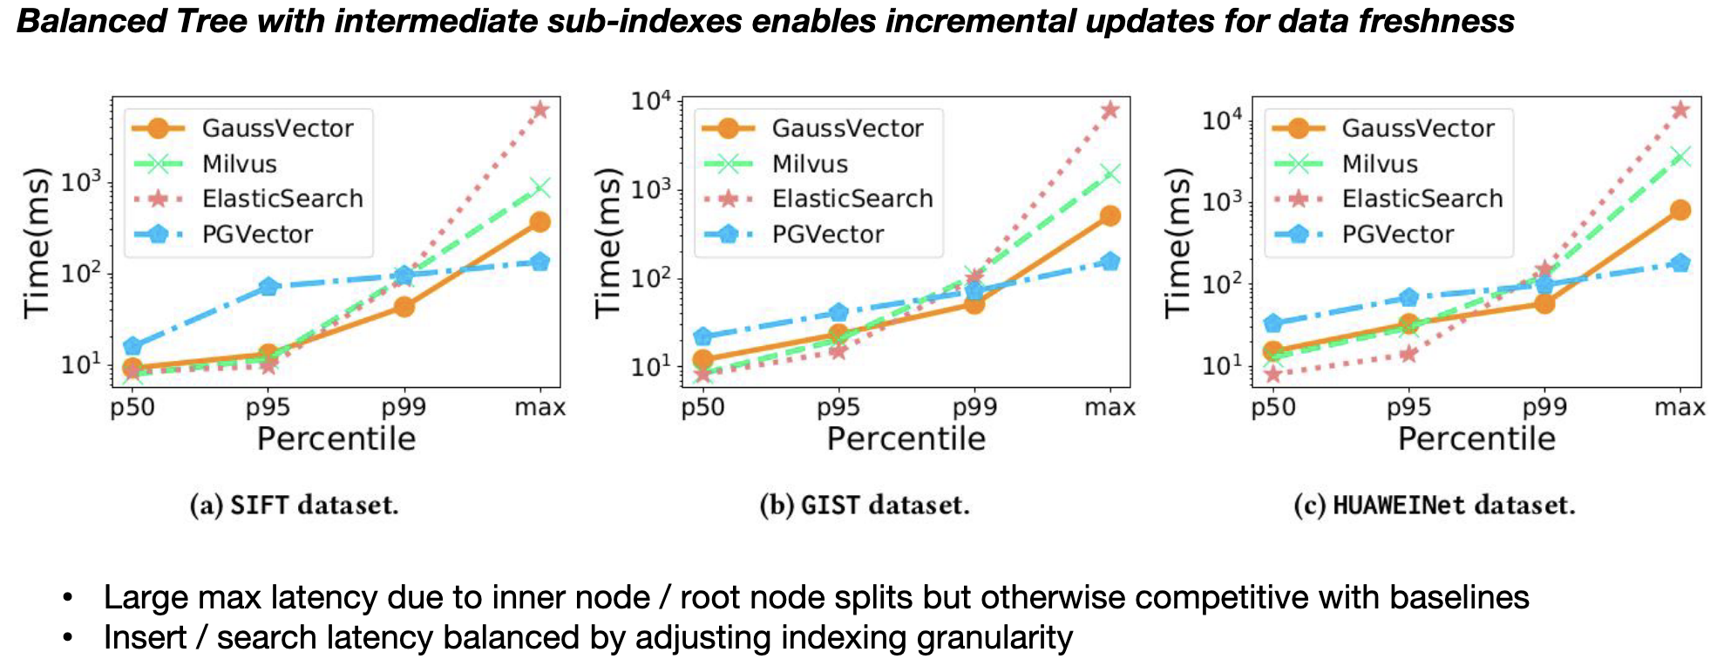
Incremental Index Updates
16

Slide 17
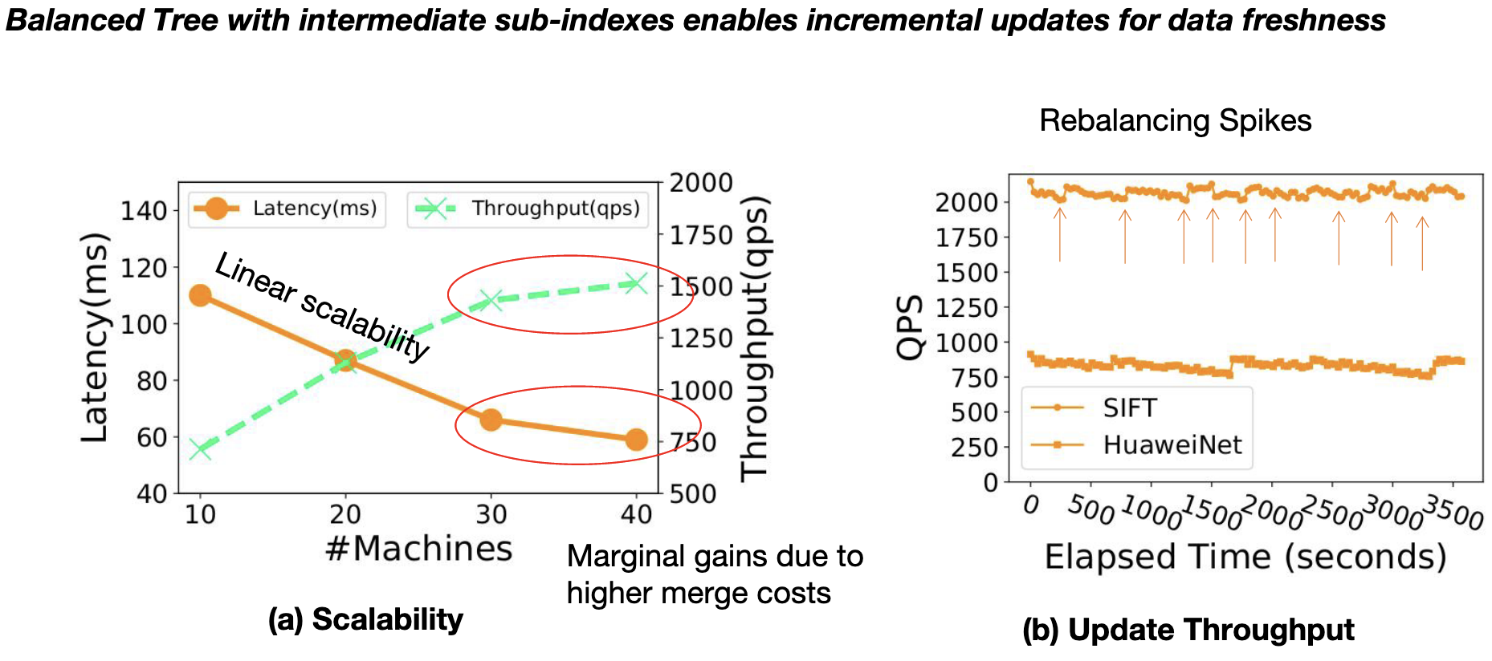
Data Sharding & Distributed Search
17

Slide 18
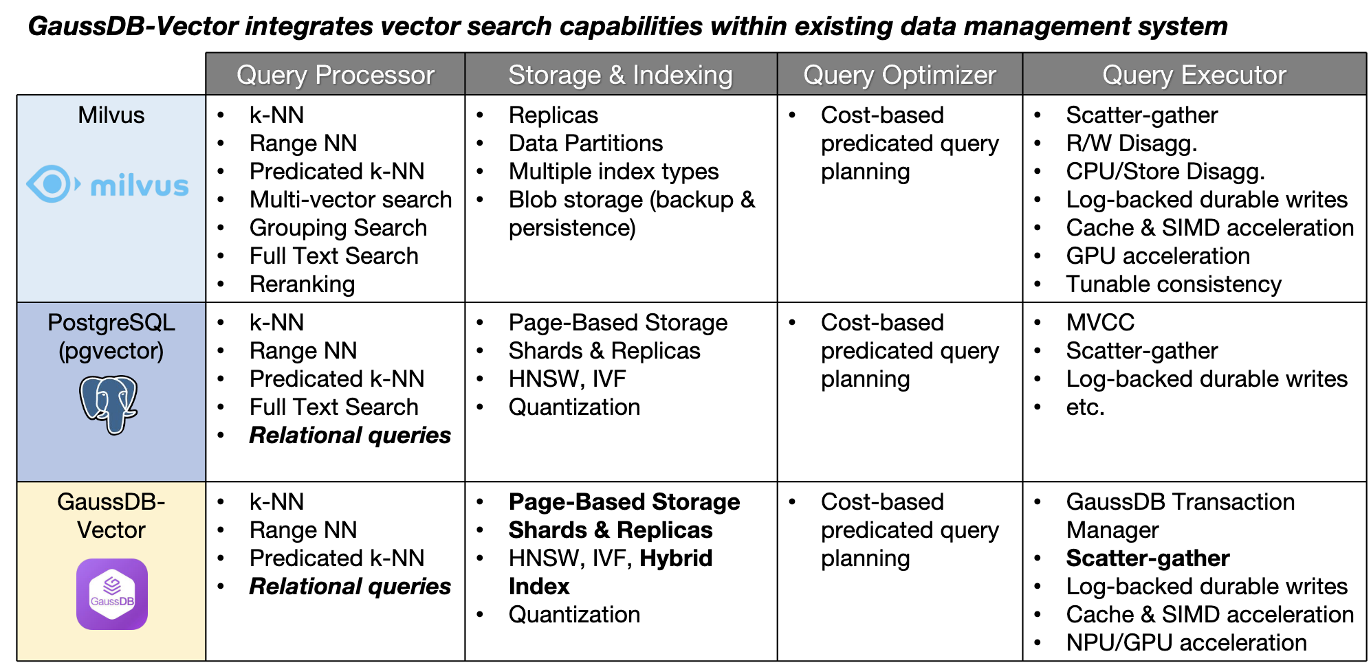
Summary & Conclusion
18

